Slide 1
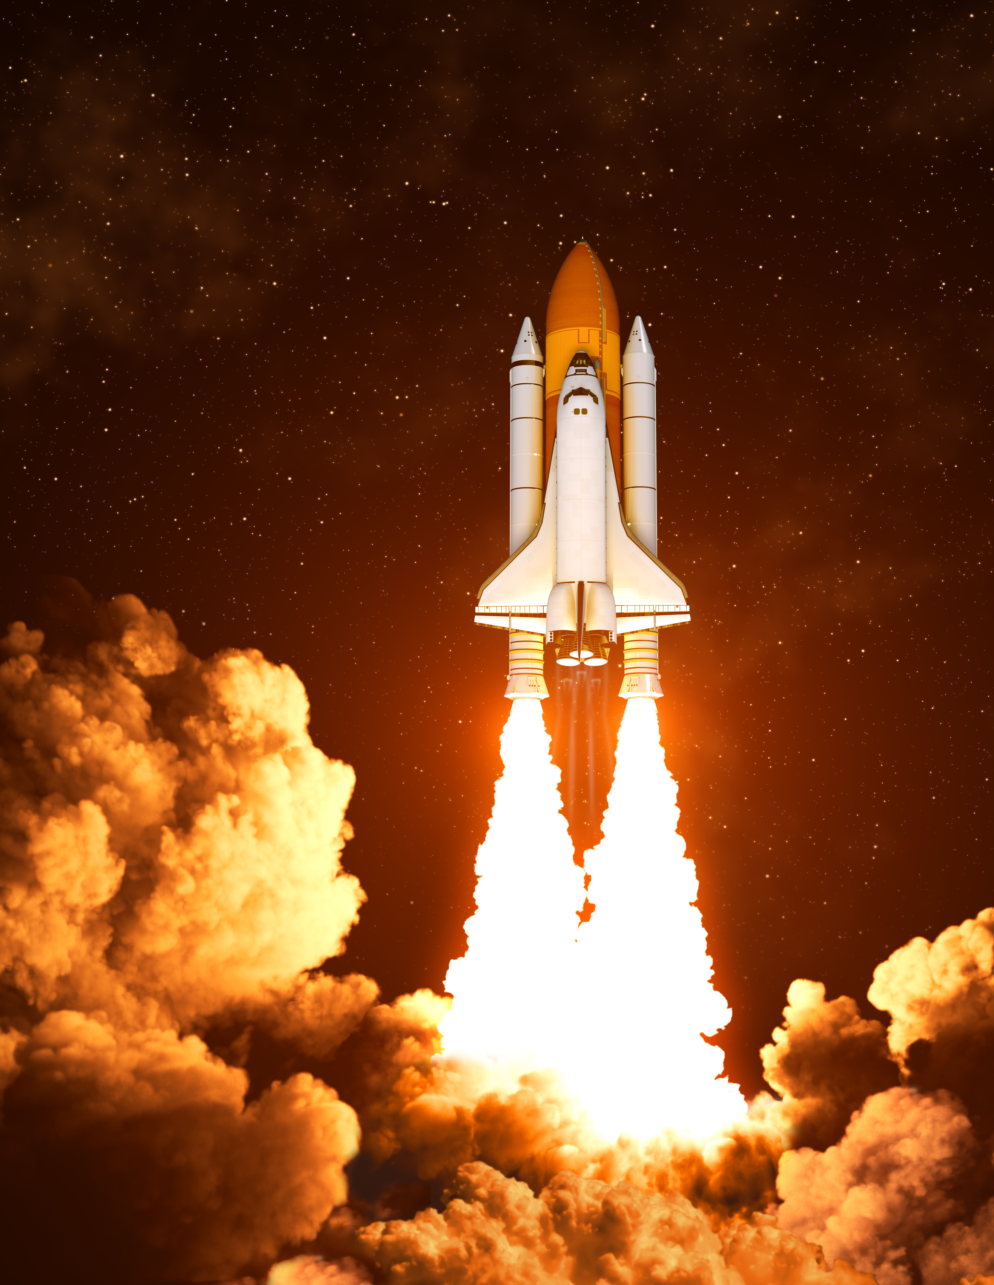

Winning the Space Race with Data Science
Anuj Suryakant gomare

Slide 2


Outline
Introduction
Executive Summary
Methodology
Results
Conclusion
Appendix

Slide 3

Introduction
The aim of this report is to predict if the first stage of SpaceX Falcon 9 rocket launches will land successfully.
SpaceX Falcon 9 rocket launches cost 62 million dollars
Other providers cost upwards of 165 million dollars​
Much of the savings is because SpaceX can reuse the first stage of Falcon9 rocket launches
If we can determine if the first stage will land, we can estimate the launch cost. This information could be beneficial to companies competing against SpaceX.

Slide 4

Executive Summary of Methodology
Data Collection
Data Wrangling
Exploratory Data Analysis
Geospacial Data Visualization
Predictive Analysis
Dashboard
Data extraction through an API
Webscraping with Beautiful Soup html parser
Transforming and loading data with Pandas
Sorting and filtering data with SQL
Data visualization using Plotly and Seaborn
Interactive maps of launch sites using Folium
SpaceX launch dashboard built in Plotly Dash
Supervised Machine Learning with sklearn

Slide 5

Data Collection
Use API requests on SpaceX REST API
Webscrape SpaceX Wikipedia entry
Combine into dataframe to get complete dataset

Slide 6

SpaceX Data Collection
Request/Parse Data
1
Convert to data frame
Filter Dataframe
2
Isolate Falcon 9 launches within the data frame
Remove Missing Values
3
Use isnull() to replace missing values with calculated .mean()
Request data from API
Decode content as .JSON format
Export to CSV
Source: SpaceX Data API

Slide 7
Falcon9 Launch Data Collection
Pull data from URL​
1
Use get() method to extract data from Wikipedia
Extract Column Names​
2
Extract all of the column names from the html table header (‘th’ element)
Create a Dataframe​
3
Parse the html tables into a Pandas DataFrame
Create Beautiful Soup object from html
Export to CSV
Source: SpaceX Wikipedia

Slide 8

Data Wrangling
Clean dataset using Pandas and Numpy
Convert complicated outcomes into Boolean results
1 = booster successfully landed
0 = booster failed to land

Slide 9
Data Wrangling
Valuecounts()
Calculate number of launches on each site
Valuecounts()
Calculate number and occurrence of each orbit type
Valuecounts()
Calculate number and occurrence of mission outcomes per orbit type
Boolean Label
0 = failed 1 = success
Create landing outcome label:
0=failure and 1=success
Export data to CSV
pd.df.to_csv()

Slide 10

Exploratory Data Analysis
Query the dataset using SQL to prepare for EDA data visualization
Plot charts using Plotly and Seaborn to gain a better understanding of the dataset

Slide 11
Exploratory Data Analysis in SQL
Use SQL queries to perform initial EDA:
Select names of unique launch sites
Filter records where launch sites begin with ‘CCA’
Calculate total payload mass carried by boosters launches by NASA
Determine avg payload mass carried by booster version F9
List date of first successful landing
List names of boosters successfully carrying payloads 4000 – 6000kg
List total number of successful and failed outcomes
List names of boosters which have carried max payload mass

Slide 12
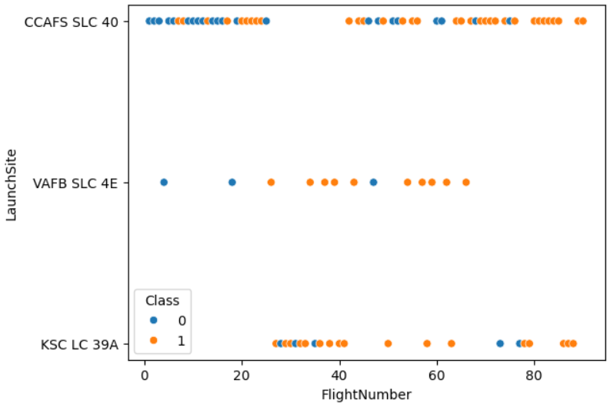
Exploratory Data Analysis in Python
Success Rates by Flight Number and Launch Site
The chance of success (orange) increases as the number of launches increase
Launch site CCAFS SLC 40 has seen the most rocket launches
KSC LC 39A has the highest number of successful launches

Slide 13
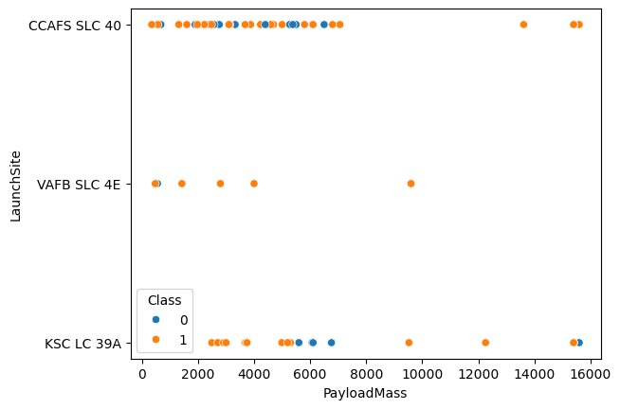
Exploratory Data Analysis in Python
Success Rates by Payload Mass and Launch Site
Higher payload mass generally results in a higher success rate
Most launches over 7000kg were successful
KSC LC 39A has 100% success rate for mass < 5500kg as well

Slide 14
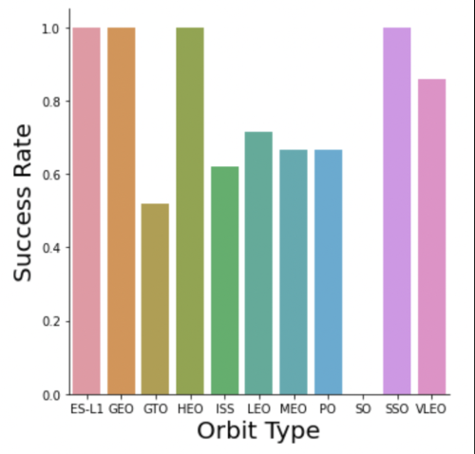
Exploratory Data Analysis in Python
Success Rates by Orbit Type
100% success:
50-85% success:
0% success:
ES-L1, GEO, HEO, SSO
GTO, ISS, LEO, MEO, PO
SO

Slide 15
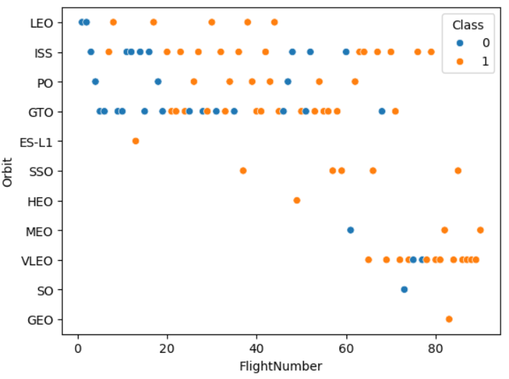
Exploratory Data Analysis in Python
Success Rates by Flight Number and Orbit Type
The LEO orbit’s success is related to the number of flights
There is no relationship between flight number in GTO orbit
ES-L1, GEO, and HEO orbit types succeeded on their only launch
SSO is 100% successful across 5 launches

Slide 16
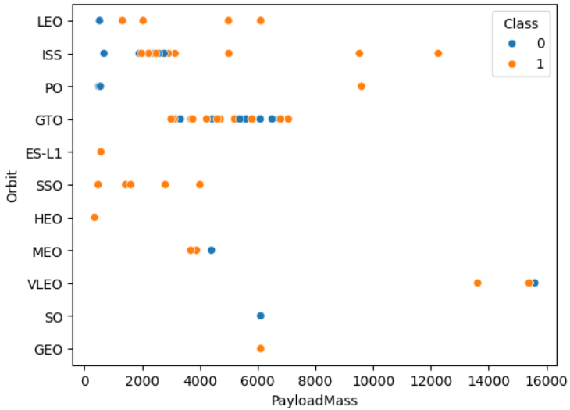
Exploratory Data Analysis in Python
Success Rates by Payload Mass and Orbit Type
If the payload mass is greater than 8000kg the Polar, LEO, and ISS orbit types appear to be more successful
GTO seems to have no relationship between payload mass and success rate

Slide 17
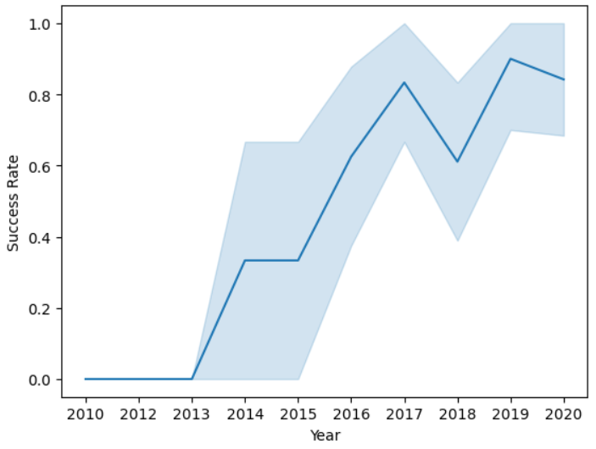
Exploratory Data Analysis in Python
Success Rates 2013-2020
The success rate of SpaceX Falcon 9 rocket launches has clearly increased over time

Slide 18

Geospacial Data Visualization
Create an interactive map using folium to visualize the success rate of launches and proximity to geographical locations of interest

Slide 19
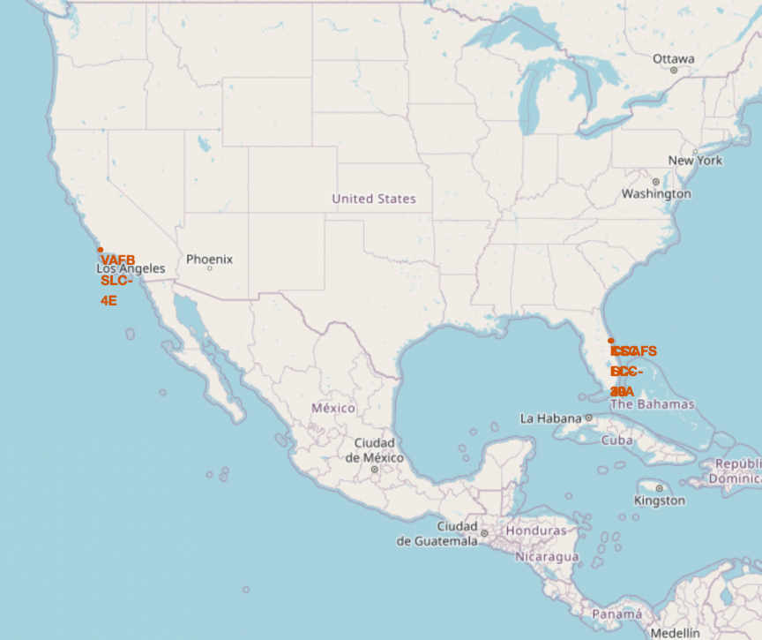
Geospacial Data Visualization
This map displays the location of SpaceX launch sites
Note that all launch sites are in proximity to the equator line
The land at the equator is moving 1670 km per hour, so launching from the equator makes the spacecraft move faster and stay in orbit once it is launched
Note that all launch sites are very close to the coast
Rockets launched over the ocean reduce the risk of debris dropping or exploding near people

Slide 20
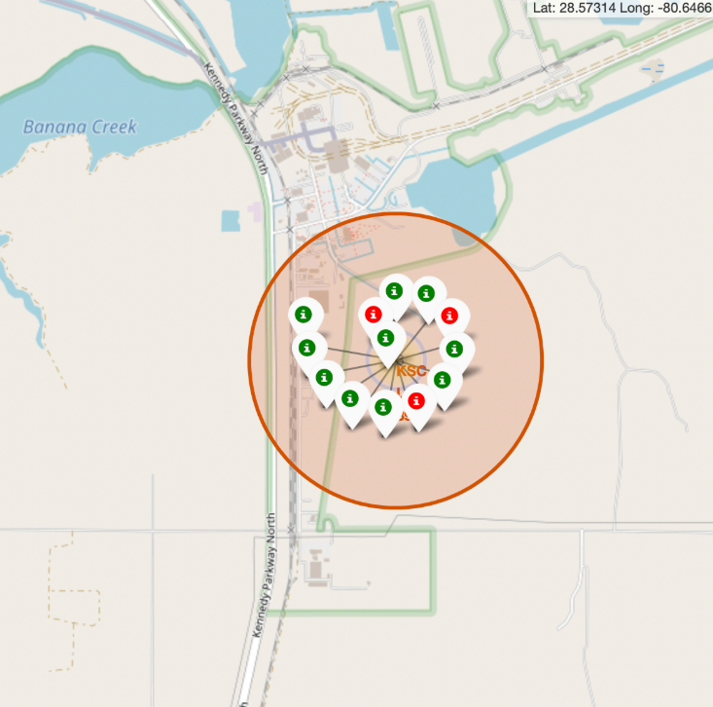
Geospacial Data Visualization
This map displays the success rates of launches at the KSC LC-39A launch site
Green = Successful Launch
Red = Failed Launch
We can clearly verify from this graphic that the KSC LC-39A launch site has a very high success rate

Slide 21
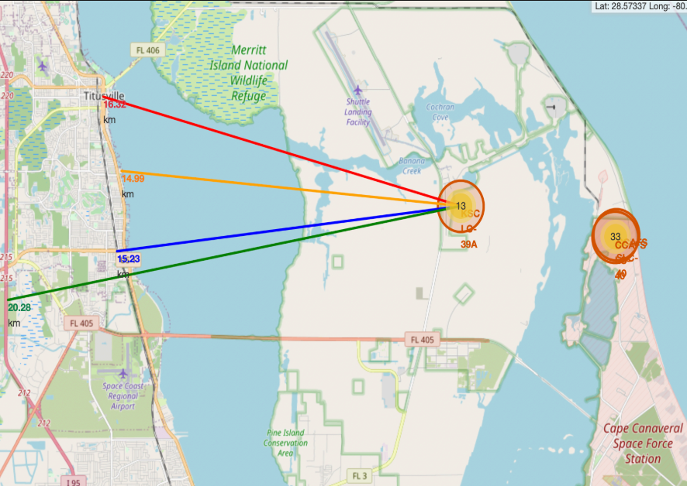
Geospacial Data Visualization
This map displays the distance from KSC LC-39A launch site to some important geographic locations:
Coastline – 14.99km
Railway – 15.23km
Titusville – 16.32km
Highway – 20.28km
Failed rockets can cover distances such as 15-20km in a matter of seconds, which could be dangerous in populated areas.

Slide 22

Launch Analysis Dashboard
Create an interactive dashboard using Plotly Dash to summarize findings from EDA process

Slide 23
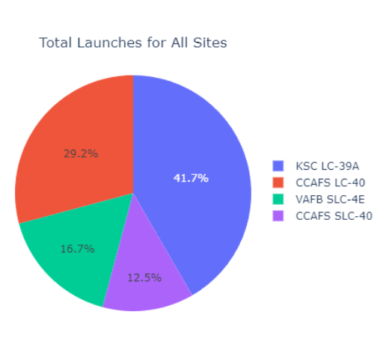
Launch Analysis Dashboard
This screenshot from the Launch Analysis Dashboard displays the total number of launches organized by launch site.
We can see that the KSC LC-39A launch site accounts for 41.7% of all launches
We could assume that the high success rate at KSC LC-39A might be correlated with the high number of launches

Slide 24
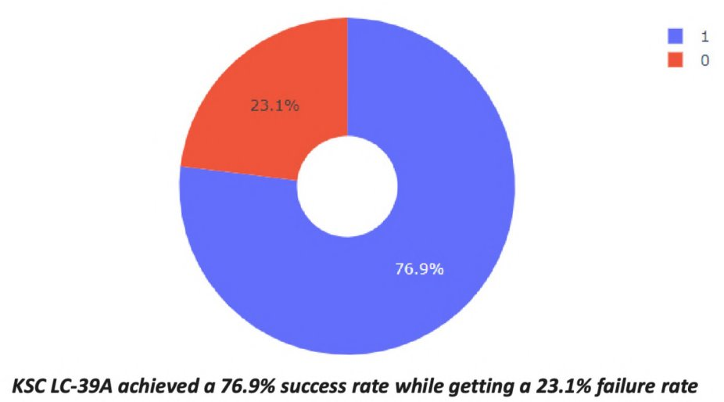
Launch Analysis Dashboard
This screenshot from the dashboard visualizes the success rate of launches from KSC LC-39A.
We can see that this site had a 76.9% success rate, the highest among all launch sites

Slide 25
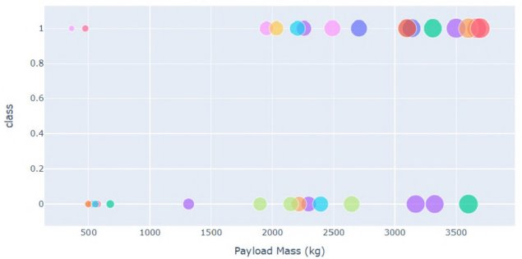
Launch Analysis Dashboard
This chart visualizes success rate by orbit type and payload mass.
1=Success and 0=Failure
When payload mass is too low, the launches are prone to failure.

Slide 26
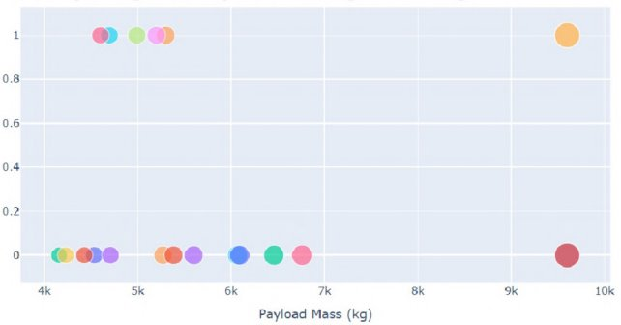
Launch Analysis Dashboard
This chart also visualizes success rate by orbit type and payload mass.
1=Success and 0=Failure
When payload mass is too high, the launches are also prone to failure.

Slide 27

Launch Analysis Dashboard
We have confirmed the following from the launch analysis dashboard:
KSC LC-39A has the highest number of launches (41.7% of total)
KSC LC-39A is the most successful launch site (76.9% success rate)
If payload mass is too low or too high, the launches are more prone to failure
A payload mass between 2000kg and 5000kg appears to offer the highest change of success

Slide 28

Predictive Analysis
Separate the dataset into training and testing sets
Train classification machine learning models and calculate accuracy on the test data to determine most effective model

Slide 29
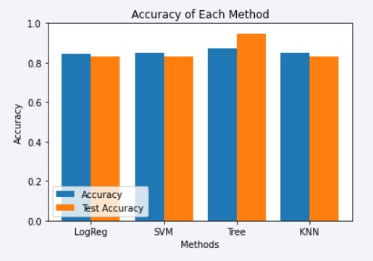
Predictive Analysis
We tested four different supervised machine learning classification algorithms on the dataset.
The bar chart to the left clearly shows that a Decision Tree Model resulted in the highest accuracy in predicting the success or failure of future SpaceX Falcon 9 rocket launches.

Slide 30
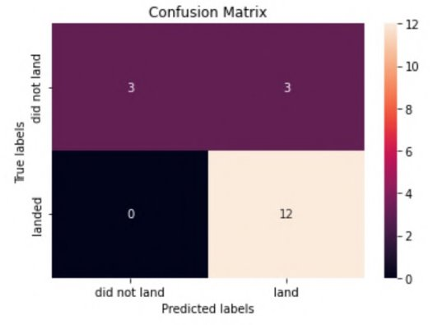
Predictive Analysis
The confusion matrix displayed on the left indicates that a decision tree model was 83.33% accurate in predicting whether rockets will land successfully compared to the testing data set.
The model is 100% accurate when predicting a rocket will not land successfully.

Slide 31
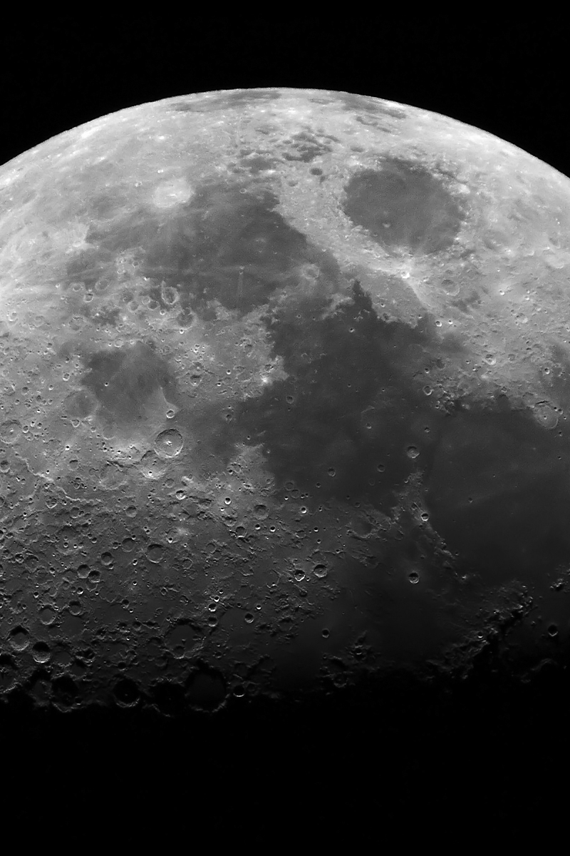
Conclusions
Chances of success have increased over time​
KSC LC 39A is the most successful launch site with 76.9% success rate​
Medium payloads (2000-5000kg) succeed most often compared to small or large payloads
The most accurate model for predicting the success of launches is a Decision Tree Model ​
The Decision Tree model is very accurate (83.33%) at predicting whether a rocket will successfully land

Slide 32
Thank you

Slide 33
Appendix
https://www.coursera.org/professional-certificates/ibm-data-science
https://github.com/anujxgomare/IBM-Capstone-Data-Science-Space-X-Project.git
https://api.spacexdata.com/v4/launches/past
https://en.wikipedia.org/wiki/List_of_Falcon_9_and_Falcon_Heavy_launches
IBM Data Science Capstone Github Repository

